Slide 1
EEE G592( Mobile & Personal Commun.)
The course will cover:
(Mobile Networks, Network Planning, Capacity
enhancement, Quality improvements, Personal
Networks, Applications and new trends)
  Evolution of Mobile cellular systems
  Related Standards
  The signal propagation
  Modulation & Demodulation
  Reuse, cell splitting ,Grade of service,….
  Coding and diversity techniques
  Multiple access schemes like FDMA, TDMA, CDMA
  GSM (Global System for Mobile Communications), UMTS(Universal Mobile Transmission systems)
  Wireless LAN
  The third generation mobile communication trends.
Notes:
FDMA: Freq divison Multiple access
TDMA: Time division multiple access
CDMA: Code Division Multiple access

Slide 2
Lecture No. | Topic | Learning Objectives | Ref. To Text & Ref. Book.
1 & 2 | Introduction & General Overview | Introduction to wireless communication and overview of mobile networks. | Ch-1 ( T1 ,R1)
3 & 4 | Modern wireless communication systems systems | Mobile and wireless, Second Generation Networks | Ch-2 (T1)
5 - 8 | Cellular Design Concept | Frequency Reuse, channel assignment & handoff strategies; interference and system capacity. Coverage improvement and system capacity. | Ch-3 (T1)
9-12 | Propagation Models | Different channel models for mobile communication. Modes of propagation. Outdoor and Indoor propagation. | Ch-4 (T1) Ch-1 (R1)
13-18 | Multipath fading | Small scale fading & Statistical models | Ch.5 ( T1) Ch.3 (R1)
19-21 | Modulation Techniques | AM, FM, Digital Modulation Schemes, GMSK, Spread Spectrum Modulation and Modulation Performance in Fading | Ch.6 (T1)
22-25 | Equalization, Diversity and Channel Coding , Speech Coding | Equalization in communication receivers, types, Diversity techniques and coding schemes for wireless systems | Ch-7, Ch.8 (T1)
26 - 30 | Multiple Access Techniques for Wireless | FDMA, TDMA,CDMA and SDMA for wireless. Packet Radio, Capacity of Cellular Systems | Ch.9 (T1) Ch.15 (R1)
31-34 | Wireless Networking | Development of Wireless Networks, fixed network transmission hierarchy, circuit switching , packet switching, wireless data services, ISDN, SS7, PCS/ PCNs, protocols, UMTS etc., | Ch-10 (T1)
35-38 | Wireless Systems and Standards | AMPS & ETACS, IS-54 , IS-136, GSM, CDMA (IS-95), PACS, PDC, PHS, PCS & ISM bands | Ch-11 (T1) & Class notes
39-41 | Wireless LANs,PANs and New Trends | IEEE 802.11 Wireless LANs,Bluetooth, WiMax | Class dicussions & notes

Slide 3
EC No | Component & Nature | Duration | Weightage | Date, Time | Nature
1. | Test 1 | 50 mints | 20% | <TEST_1> | CB
2. | Test 2 | 50 mints | 20% | <TEST_2> | OB
3. | Assignments/ Lab assign. | - | 20%
2. | Compre. Exam | 3 Hrs | 40% | <TEST_C> | CB/OB

Slide 4
Text Book:
  “Wireless Communications Principles and Practice” by Theodore S. Rappaport, Second Edition, Pearson Education Asia, 2002
Reference Book:
“Mobile Communication Engineering” WCY lee, Mc-Graw-Hill, International Editions (1998).
Wireless Network Evolution: 2G to 3G, V K Garg, Pearson Education Asia, 2002
Wireless Communications & Networks, William Stallings, Pearson Education,Asia, 2002

Slide 5
Wireless Communication Lab
GSM kit for control switching operation
RFID experiments
Bluetooth experiments
WLAN setting and measurement experiments
Wireless sensor networking
NS2 based projects( Wireless Networks )

Slide 6

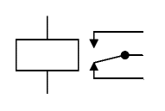

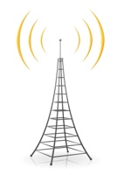

GSM Based Intelligent Instrumentation (Block Diagram)
AC SUPPLY
RELAY
8051 MICRO CON
GSM MODEM
APPLIANCE
BITS Pilani

Slide 7
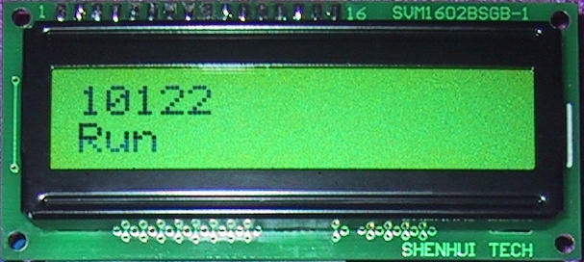
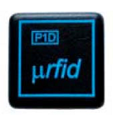
RFID BASED SECURITY / ATTANDENCE SYSTEM
Alarm
8051
Tx
PORT 2
Rx
DATA PIN
RFID
TAG
BITS Pilani

Slide 8
Wireless Comes of Age
Guglielmo Marconi invented the wireless telegraph in 1896
  Communication by encoding alphanumeric characters in analog signal
  Sent telegraphic signals across the Atlantic Ocean in 1901
Communications satellites launched in 1960s
Advances in wireless technology
  Radio, television, communication satellites, wireless networking, cellular technology

Slide 9
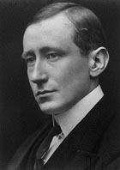
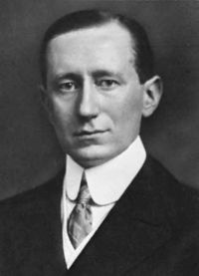
Guglielmo Marconi
(Rome, Italy) (1874~1937)

Slide 10
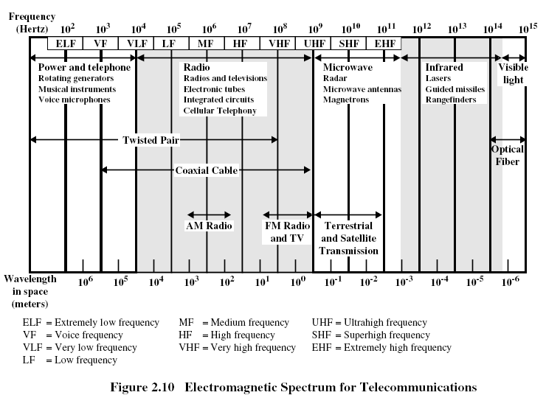

Slide 11
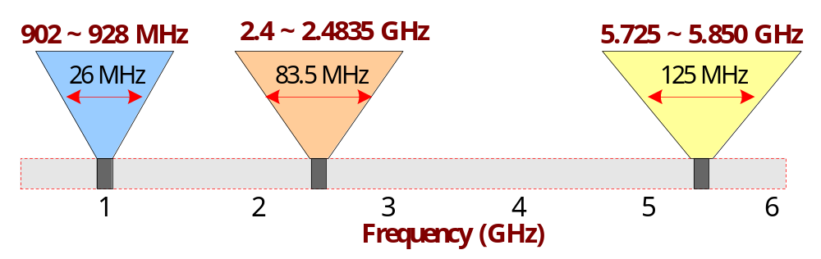
ISM (Industrial, Scientific Medical) Band
    902 ~ 928 MHz
    2.4 ~ 2.4835 GHz
    5.725 ~ 5.850 GHz

Slide 12
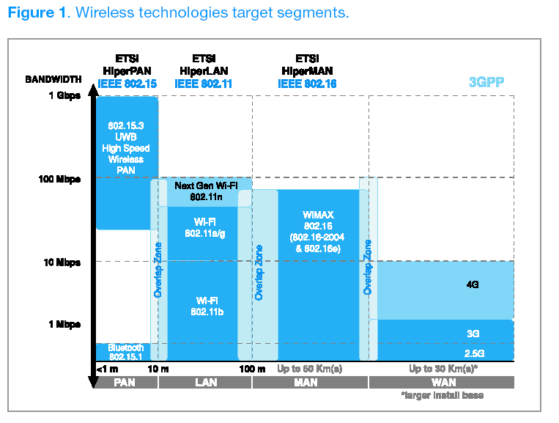
Wireless Networks Trends
BITS Pilani

Slide 13
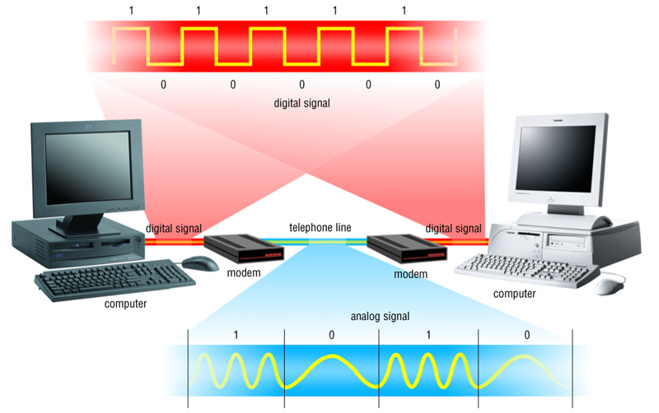
Communication Systems

Slide 14
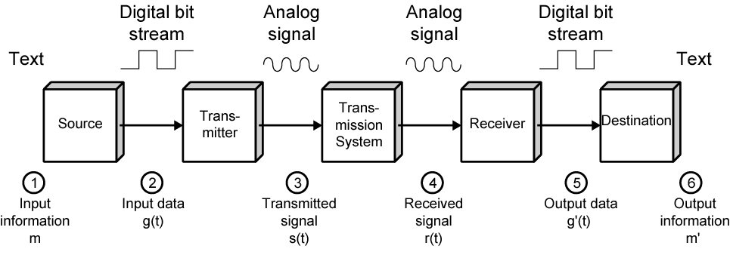
Data Communications Model

Slide 15
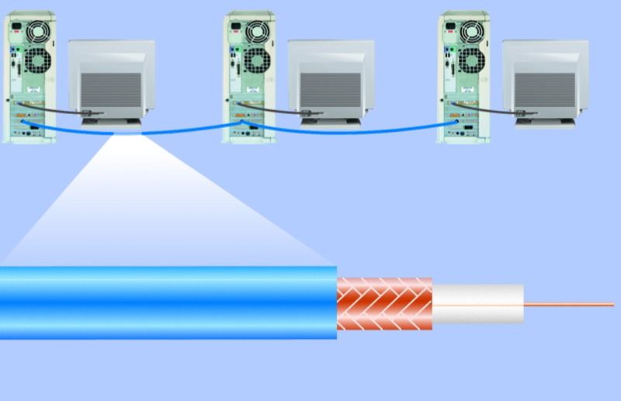
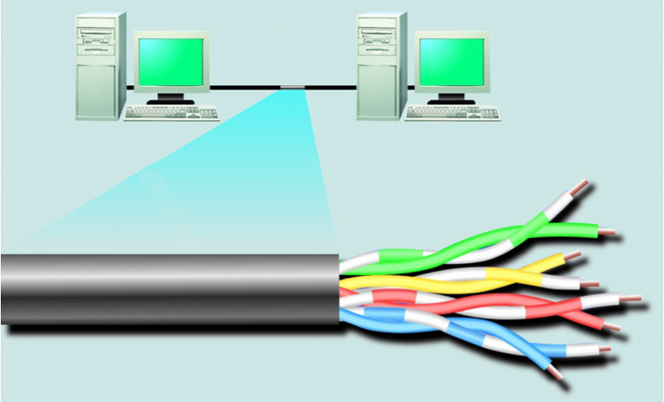
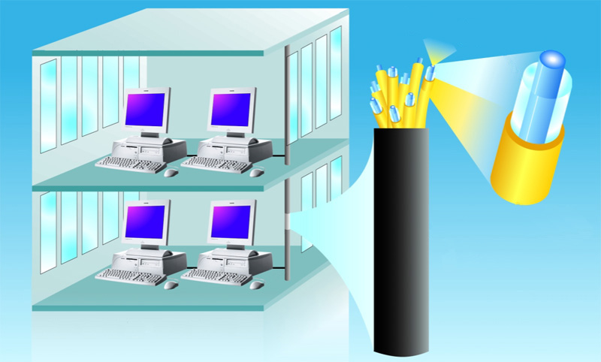
Physical Transmission Media
woven or braided metal
twisted-pair cable
twisted-pair wire
copper wire
plastic outer coating
insulating material
optical fiber core
glass cladding
protective coating

Slide 16
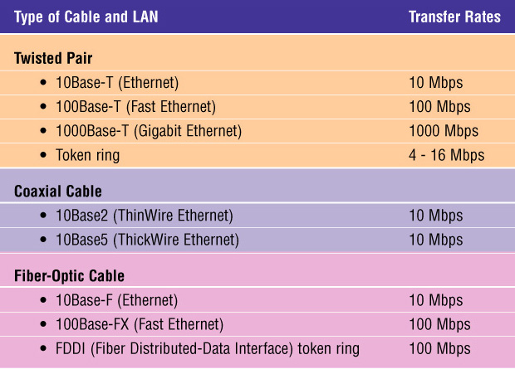
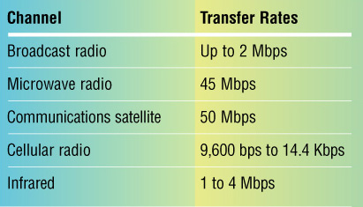
Physical Transmission Media
Wireless channel capacity:
100 Mbps is how many bits per sec?
Which is bigger:
10,000 Mbps, 0.01Tbps or 10Gbps?

Slide 17
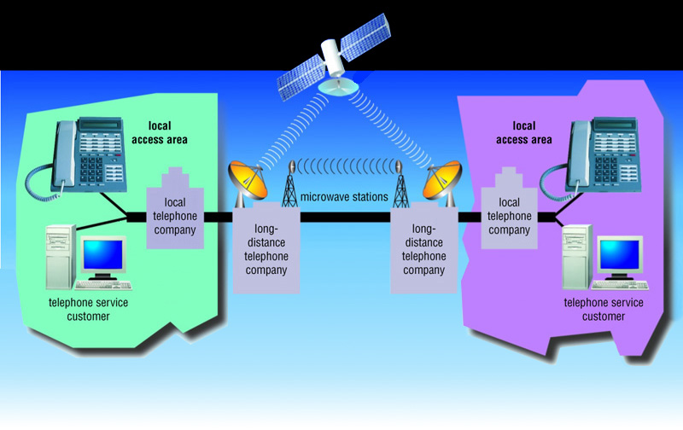
Network Example:
Telephone Networks

Slide 18
Basics: Structure
Multiple Access
Downlink
Handoff
Uplink
Mobile Station Distributed transceivers
Base Station Fixed transceiver
Cells Different Frequencies or Codes

Slide 19

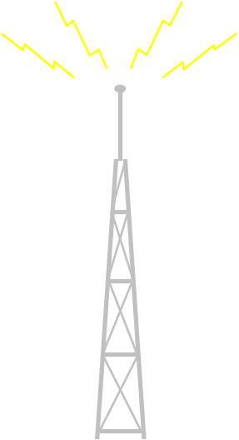

Basic Cellular System
PSTN/ISDN
Switch
BITS Pilani

Slide 20
Mobile phone features
Basic Features of Mobile phones
  Voice Communications
  Short messaging system (SMS) text messages
Advanced features
  Internet browsing, music (MP3) playback,
  personal organizers/ e-mail,
  built-in cameras and camcorders,
  ringtones, games, radio
  Push-to-Talk (PTT),
  infrared and Bluetooth connectivity, call registers
  ability to watch streaming video or download video for later viewing,
  and serving as a wireless modem for a PC.

Slide 21
Wireless Mobile Communication
Introduction to Wireless Communication System
Fundamental of cellular concept
(Frequency reuse, Channel assignments, Interference and System capacity, Trunking grade of service, capacity improvement)
Radio Propagation
Modulation and Coding

Slide 22
Wireless Mobile Communication
Link improvement techniques
Multiple Access Techniques
Wireless Networking
Wireless System and Standards
Physical layer-Trans-medium-receiver
Data link layer- reliability-error correction-multiple access
Network layer-routing-QoS-flow/congestion control

Slide 23
Wireless Network related fields

Slide 24
Radio-AM-520KHz-1605KHz ( MW)
5.9 MHz-26.1MHz ( SW)
FM-88MHz—108 MHz
Analog TV- 174 -230 MHz,470-790MHz and 1452-1472 MHz
Digital TV -470-862 MHz

Slide 25
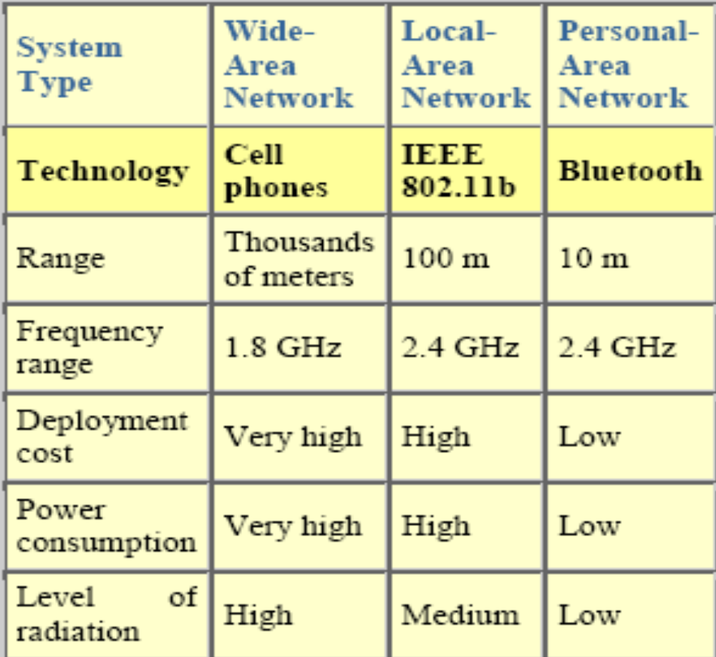

Slide 26
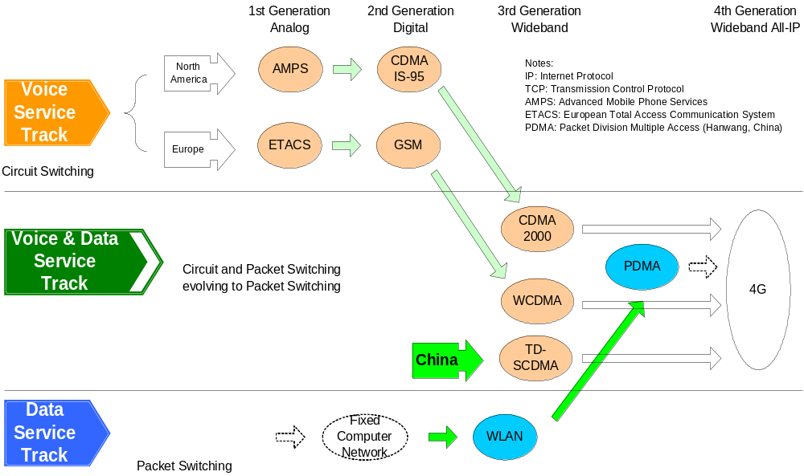
Evolution of
Mobile Radio Communications

Slide 27
Paradigm From 1G to Beyond 3G
First Generation
Second Generation
Third Generation
Beyond Third
Generation
Analogue
Circuit switched
Basic voice telephony
Low capacity
Limited local and regional coverage
Digital
Circuit switched
Voice plus basic data applications
Low data speed
Enhancements towards
  packet switching
  higher data rates
Trans-national and global roaming
Digital
Packet and circuit switched
Advanced data (multimedia) applications
Fast data access
Global coverage
Global roaming
Digital
Packet switched
All IP based (IPv6)
More advanced multimedia applications
User in control
Flexible platform of complementary access systems
High speed data
Improved QoS
Global coverage
Global roaming

Slide 28
Trends in Wireless Commun.
Personal Communications (Goal of mobile communications)
All IP based (IPv6) (Packet switched)
Flexible platform of complementary access systems( Combination of different wireless access systems, Hot spot services will be introduced by high-speed wireless access (>100mbps))
Higher system capacity (Users/Service, 5-10 times higher than 3G)
Higher Transmission Data rate
Higher frequency efficiency
More advanced multimedia applications
Improved QoS
Realize high levels of security and authentication
Global coverage
Global roaming

Slide 29
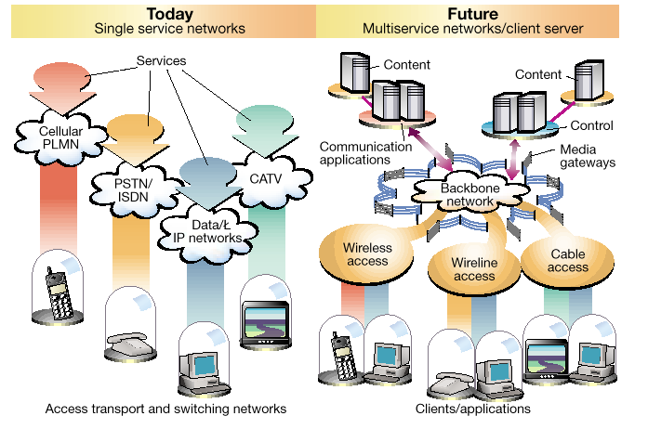
All IP Based

Slide 30



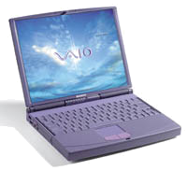

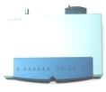
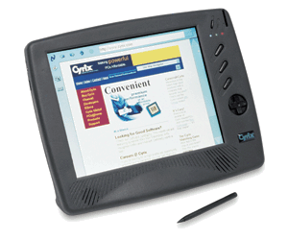





All IP based
Mobile Internet
Application Servers
Broadband Accesses
Network Domain
Mobile Internet
Application
Platforms
Mobility, Connection
& Control Servers
Broadband
Gateway
OWLAN
Service Domain
Internet
IP Multi
Radio
IP/ATM/MPLS Backbone
Mobility
Gateway
PSTN
ISDN
Intelligent Edge
Media
Gateway

Slide 31


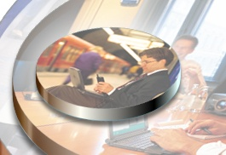
Combination of different wireless access systems
IEEE.802.11
WLAN
PAN Bluetooth
PDMA
WPAN WLAN WWAN

Slide 32
Transmission Data Rate
Highest data rate(3G)
  at least 144 Kb/s in a vehicular environment,
  384 Kb/s in a pedestrian environment,
  2048 Kb/s in an indoor office environment.
Highest data rate (4G)
  2Mbps in a vehicular environment,, 20Mbps in a pedestrian environment
  Wide Area, high velocity：100Mbps
  Indoor, lower velocity：1Gbps
Evolution of transmission data rate
2G
evolved 2G
3G and beyond
9.6-14.4 kbps
64-144 kbps
384 kbps-2 Mbps
384 kbps-20 Mbps
100 Mbps?

Slide 33
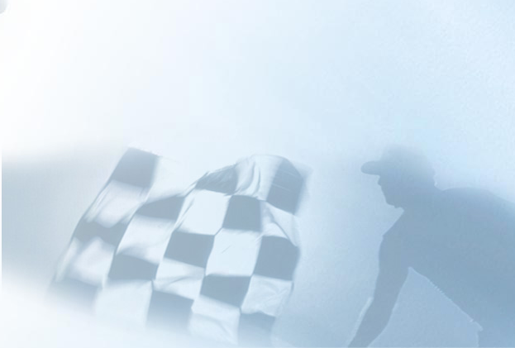
Drivers of 3G Beyond
Subscriptions (millions)
1800
Mobile
User
1600
Mobile
Fixed
Mobile Internet
Fixed Internet
1400
3G evolution …but difficult
  to extend to higher data rate with CDMA only technology;
  to provide various services with different QoS
  to have enough frequency resource to accommodate more subscribers
Drawback
  Low system capacity
  Low spectrum efficiency
1200
1000
Mobile
Internet
User
800
600
400
200
0
1995
2000
2005
2010
Pbit/day
150
125
Non Real Time
(e.g. Internet access)
100
75
50
Real Time
(e.g. Voice)
25
0
1998
1999
2000
2001

Slide 34

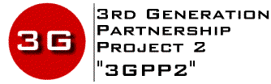
Drivers of 3G Beyond
Revolution from IP infrastructure
IP
Evolution from 2G systems
3G
and Beyond
2G
Revolution from subscriber service expectations

Slide 35
Service Forecast for Asia Region
25
23?
① Multimedia traffic increases 40%/year.
② 10Mbps downstream service emerges.
③ Saturation of 1G/2G services traffic.
19.8
20
Multimedia
④ (U:128k,D:10Mbps)
③ (U:128k, D:2Mbps)
② (U:64k,D:384kbps)
① (U/D:128kbps×n)
④
15%
15
Voice : Multimedia traffic ratio
∼ 1 : 2 (in 2010)
③
Relative traffic value in bits (Ref: 1999)
30%
10
91 %
Subscribers ×1.5
5.4
②
1G/2G services
Voice (U/D: 16k, VOX0.5)
Others (<64 kbps)
5
28%
1
3.9
3.4
1.5
63%
10％
①
8%
0
0.5
0.5
9 %
Up
Down
Up
Down
Up
Down
1999
2010
2015
(Extrapolation)
Year
(Forecast by ITU-R TG-8/1 for Asia)

Slide 36
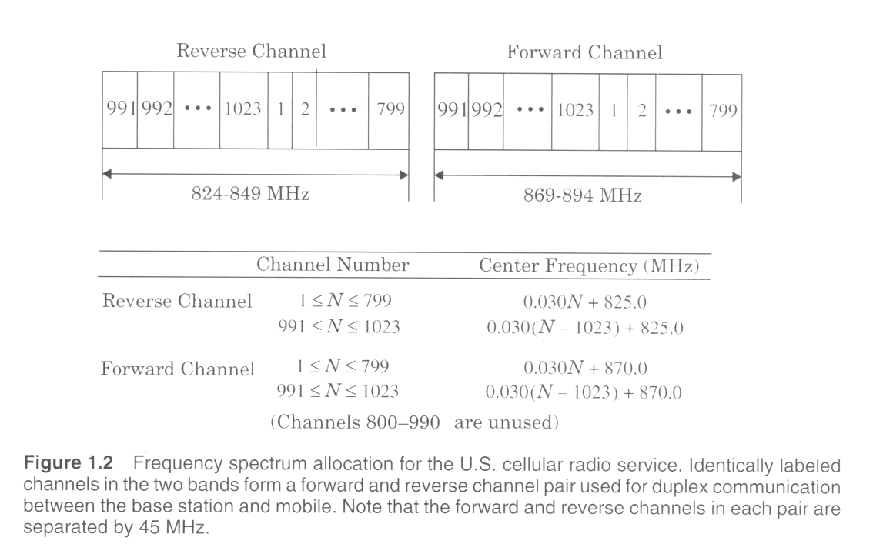
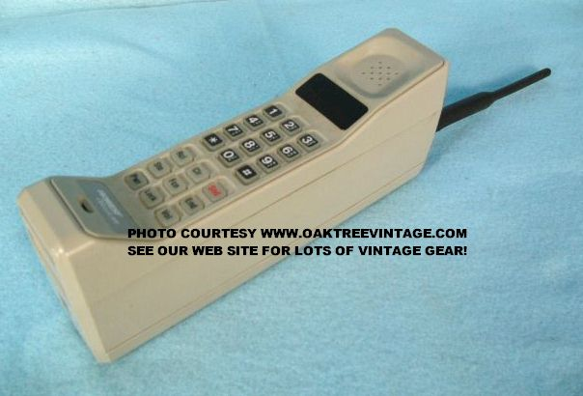
Mobile Radio telephone
AMPS:
advanced
mobile phone
system
EE 542/452 Spring 2007

Slide 37
Drivers for Mobile Comms Growth
Advances in Large Scale circuit integration
Continued improvements in Digital and RF circuit Fabrications
Miniaturization techniques
Battery life improvement
Bandwidth efficient modulation Techniques.
Cellular concepts: ATT developed the concept in 1950 to 1960s. In 1968 it presented the cellular concept to FCC
Favorable frequency allocations by regulators
Notes:
FCC: Federal Communication Commission

Slide 38
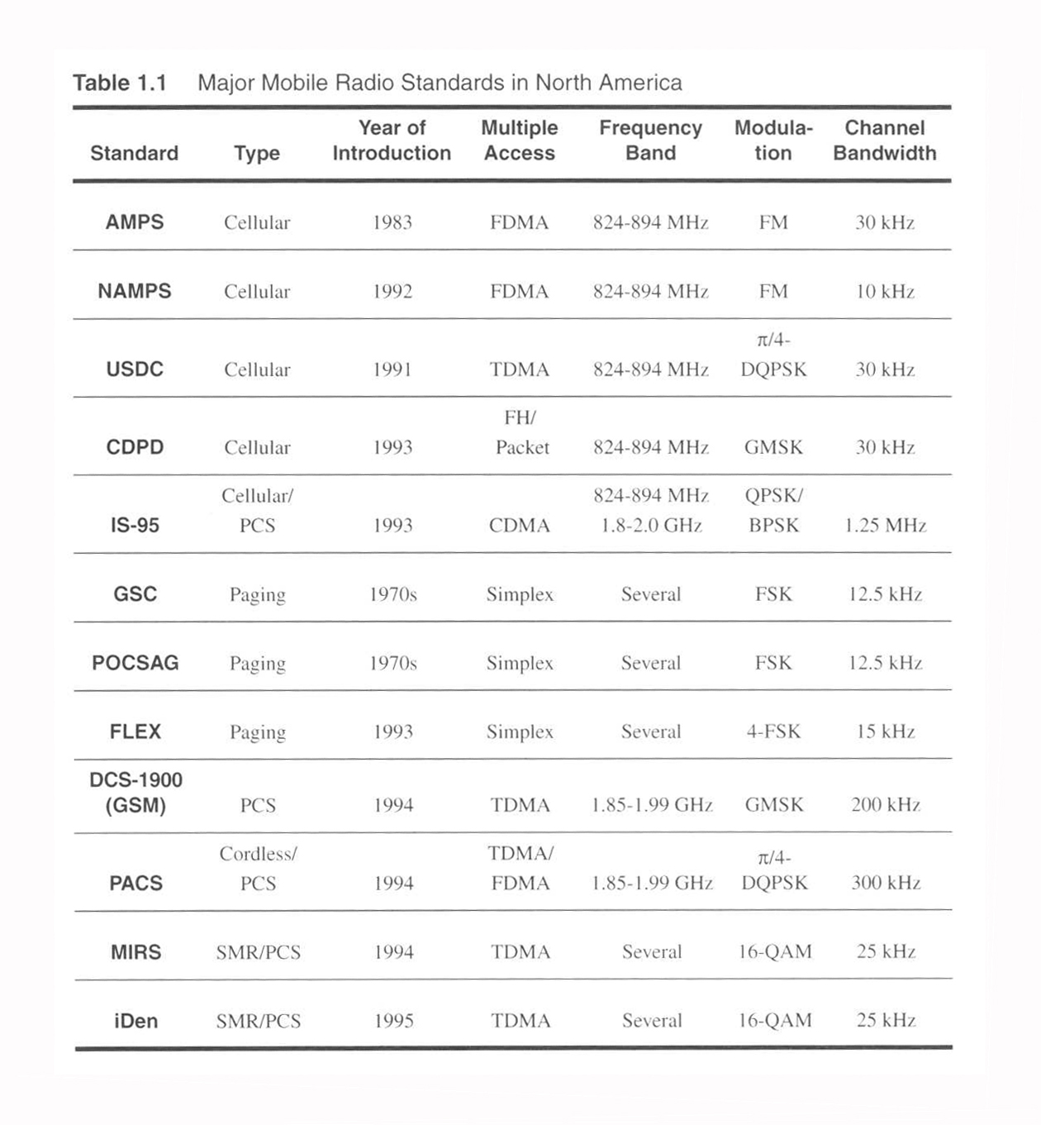
Mobile Standards in North America
Notes:
AMPS: Analogue Mobile Phone System
NAMPS: Narrow Band AMPS
USDC: United States Digital Cellular (IS-54)
CDPD: Cellular digital Packet data
POCSAG: Post Office code Standard Advisory group
GSC: GGolay sequential coding a 600 Bps paging standard)
GMSK :Gaussian minimum shift key
MIRS: Motorolla Integrated radio system
iDEN : Integrated enhanced digtal network
CDPD: Cellular digital packet data

Slide 39
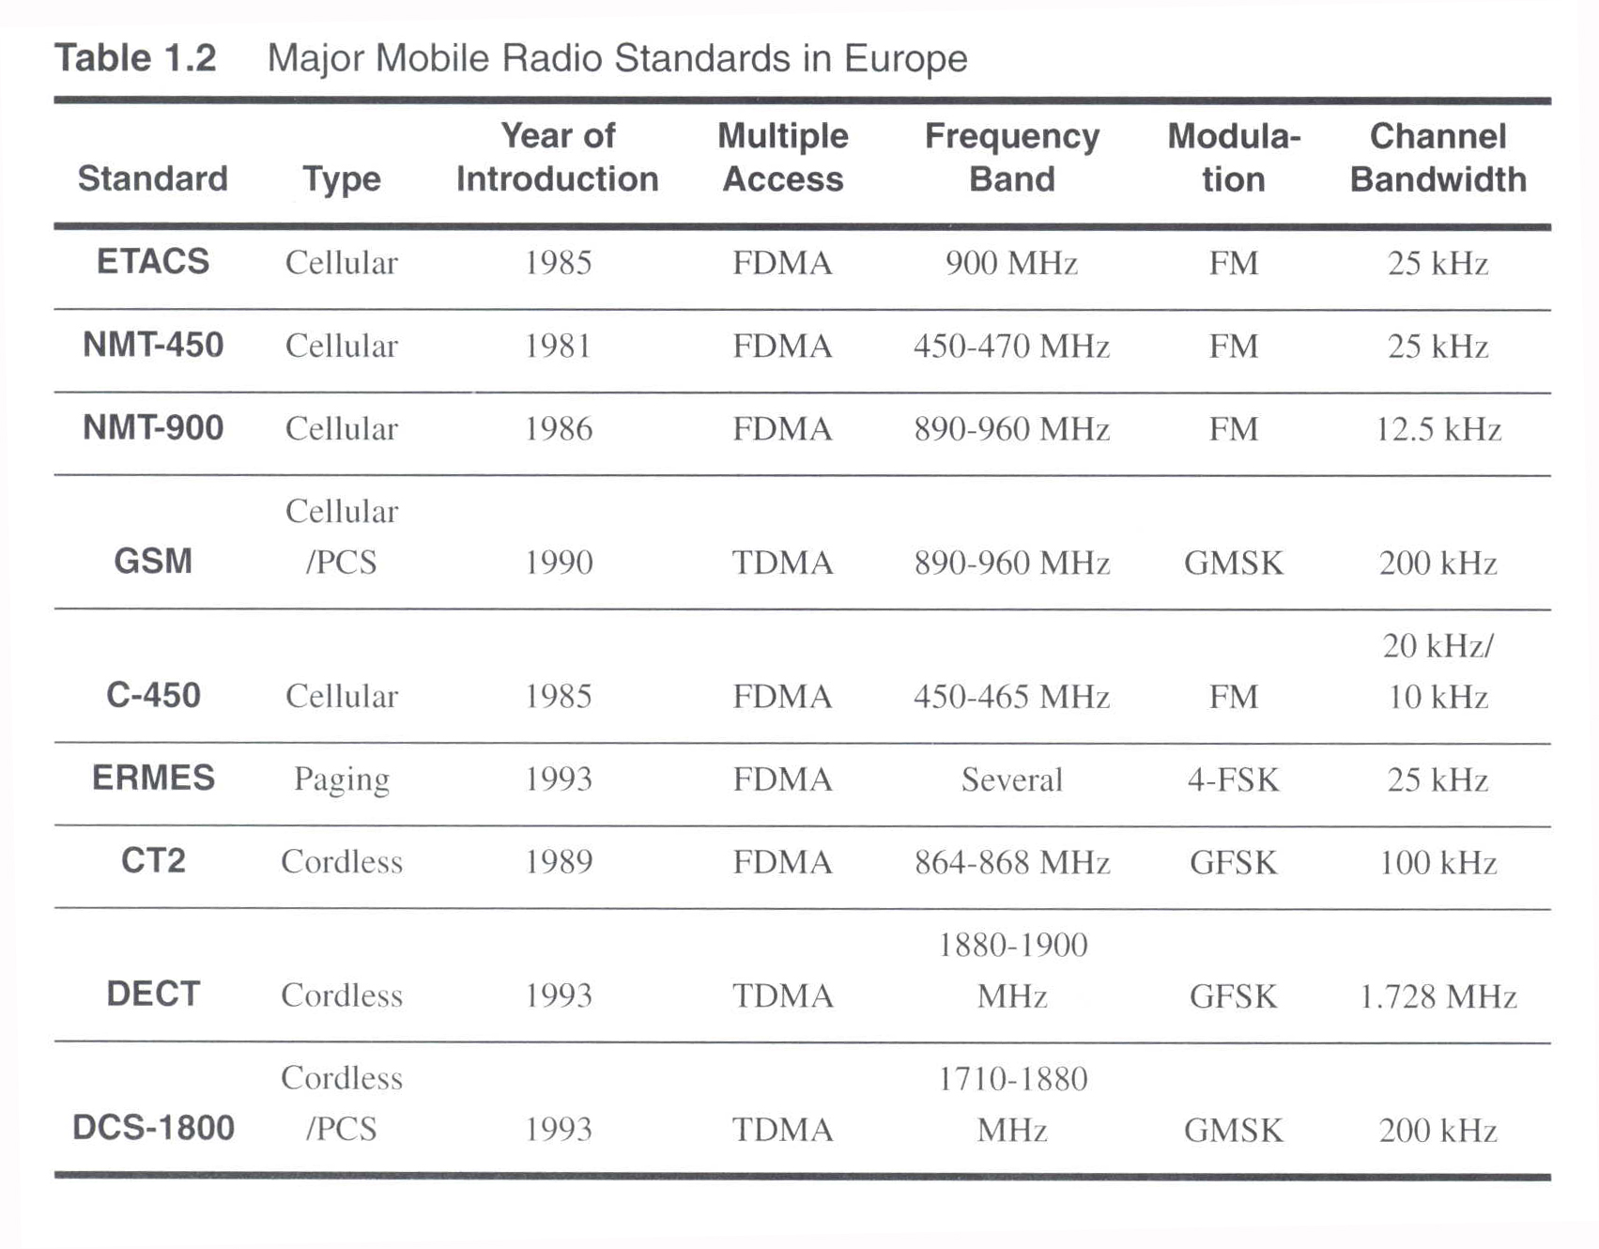
Mobile Standards in Europe
Notes:
ETACS: Exteneded total access communication systems
NMT-450: Nordic Mobile Telephone system
GSM : Global system for mobile communications
ERMES: European radio message system
DECT: DECT: Digital European cordless telephony

Slide 40
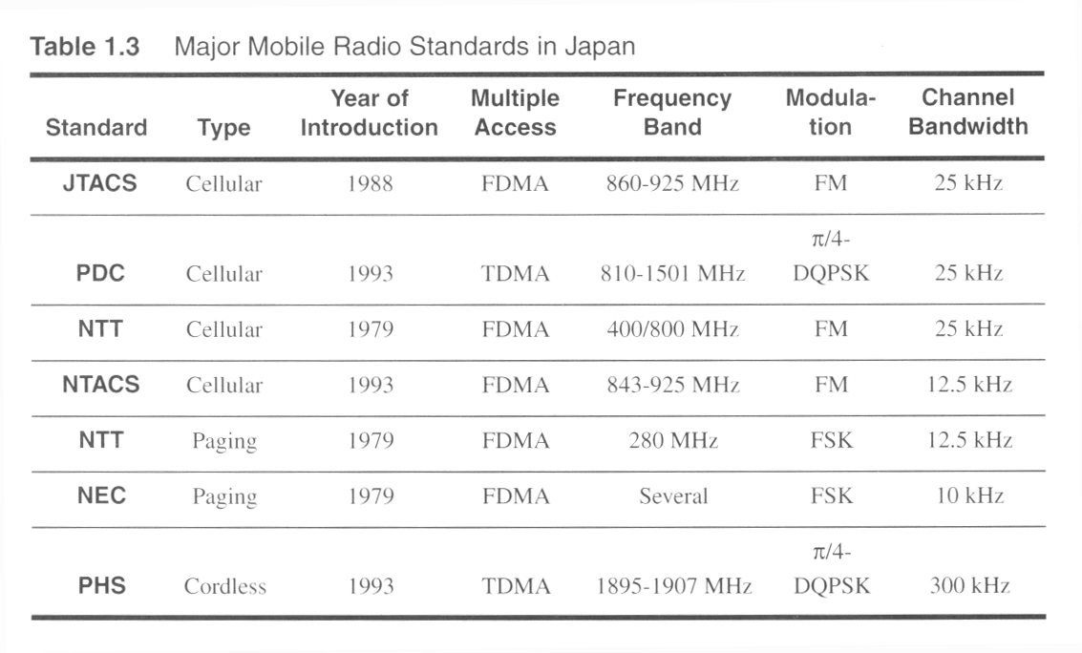
Mobile Standards in Japan
Notes:
JTACS: Japaneese total access communication system
PDC: Pacific didital cellulay
NTT: Nippon telephone and telegraph
NTACS: Narrowband total access communication system
NEC: National
PHS: Personal Handyman system

Slide 41
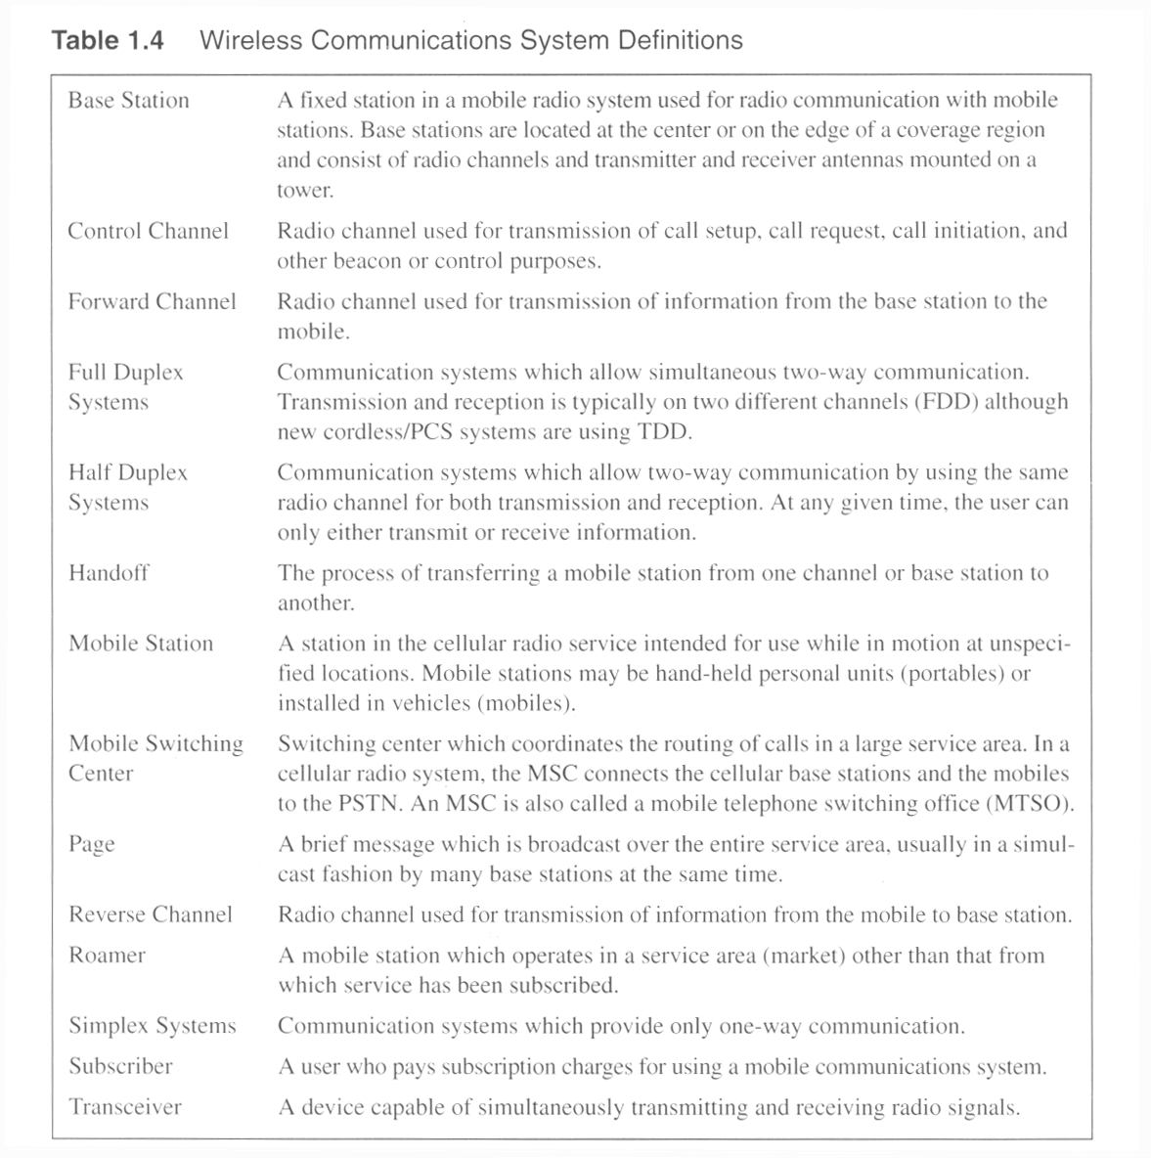
Wireless communication definitions

Slide 42
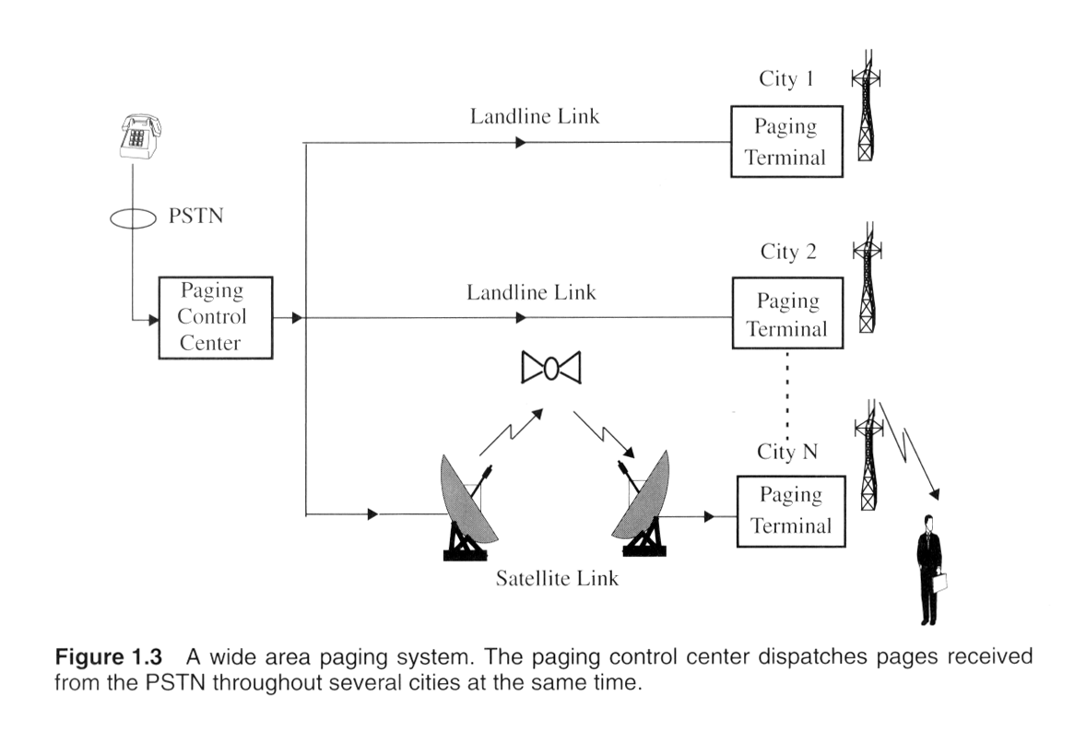
Wide area Paging system
Notes:
Paging is usually one way. It can be Numeric, alphanumeric or a voice message. They are used to notify a subscriber that they need to call back or get in touch with somebody. Some applicatios are:
New headlines
Stock quoattions
Fax
Network management
Distance and coverage:
Inside a building
Simple : 2 to 5 Kms
Wide area paging : worldwide coverage.
Concept is simple but the transmission systems are quite complicated

Slide 43
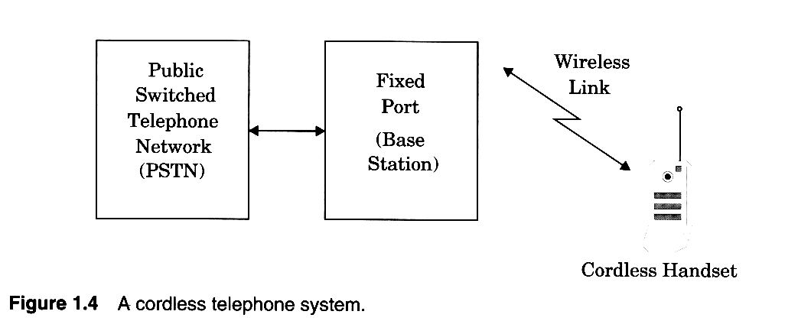
Cordless handsets
Notes:
First generation Cordless phones were sued inside the house. Connects to Wired telephone system and range is few tens of a meter.
Limited range and mobility

Slide 44
Definition of Mobile and Portable
Mobile
  Previously
    any Radio Terminal that could be moved during operation.
  Now
    Radio Terminal that is attached to a high speed mobile platform.
Portable
  as a Radio Terminal that can be hand-held and used by someone at walking speed: Cordless Telephone at home, or walkie talkie
Subscriber – Mobile or portable user.Each user’s communication device is called Subscriber unit.
Base stations – Links mobiles to a backbone network.

Slide 45
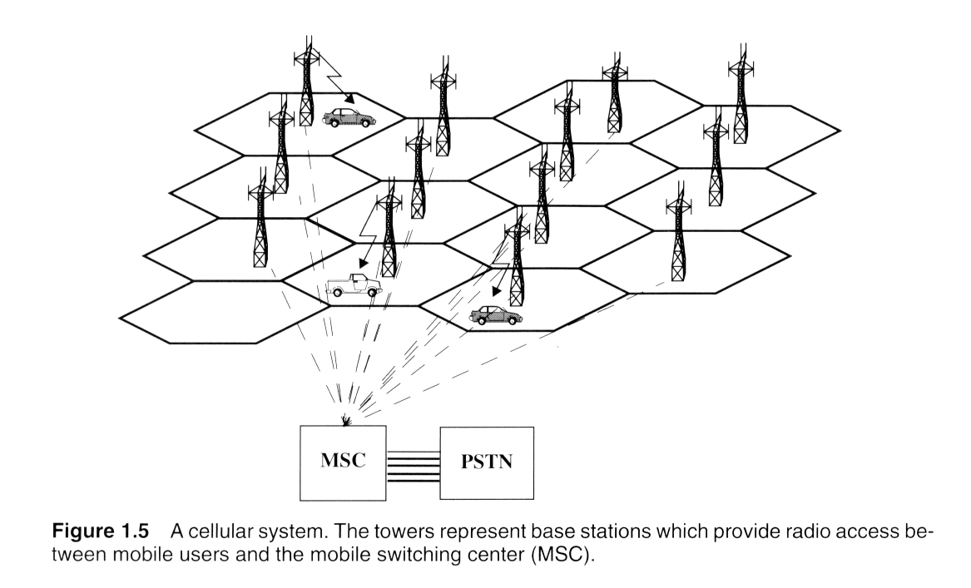
Cellular system Concept
MSC is also called Mobile telephone switching office (MTSO)
Notes:
A basic system comprises :
Cellular subscriber phones
Base station
Mobile switching center
The cellular network is connected to public telephone network.
High capacity is achieved by limiting the coverage of each base station transmitter to a small geographic area is called cell so that the same radio channels may be reused by another base station located some distance away. A sophisticated switching technique called a handoff enables a call to proceed uninterrupted when the user moves from one cell to another.
Each cell uses different freq channels.
Cellaular systems use standard freq plan. The voice and control channels are defined. Normally 95% of channels are used for information communication while only 5% are used for signaling purposes.
Switching system, called handoff, enables call to proceed uninterrupted when the user moves from one cell to another.
Typical MSC handles 100,000 cellular users and 5,000 simultaneous conversations at a time.

Slide 46
Terminologies involved in Cellular Phone Systems
Mobile Identification Number (MIN): Subscriber’s Telephone No.
Electronic Serial Number (ESN): Serial No. of the Mobile
Station Class Mark(SCM): It indicates the maximum Transmitter
power level for a particular user.
International Mobile Subscriber identity number ( IMSI) Ex: GSM
First 3 digit ( Mobile country code : MCC); next 2 mobile Network code ( MNC); Next 10 Mobile subscriber Identity no.( MSIC)
262 02 454 275 1010 ( Germany; Optus commun; MSIC ) (India-404,405) (Airtel 02-Punjab,03 Himachal Prade, 10- Delhi NCR 900 MHz)

Slide 47
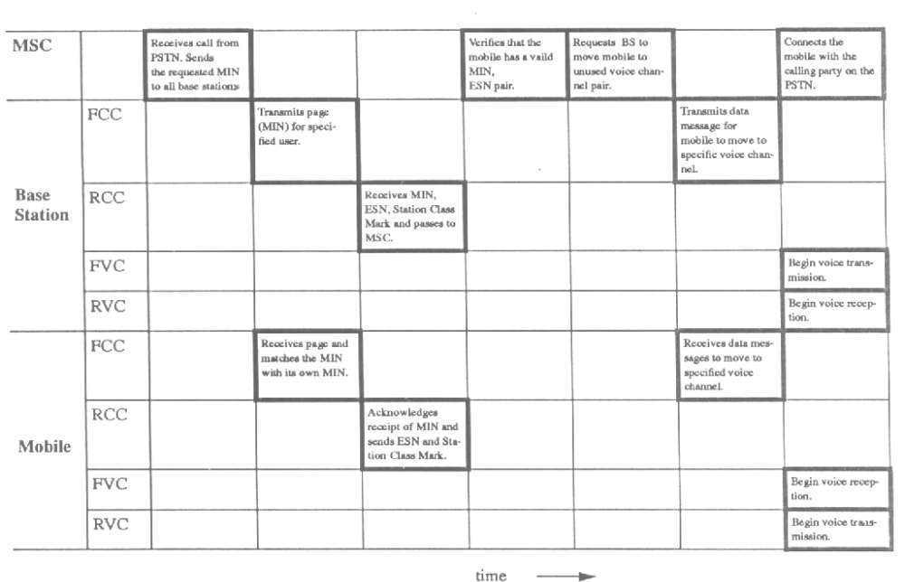
Timing Diagram when a call is made by a Landline User to a Mobile

Slide 48
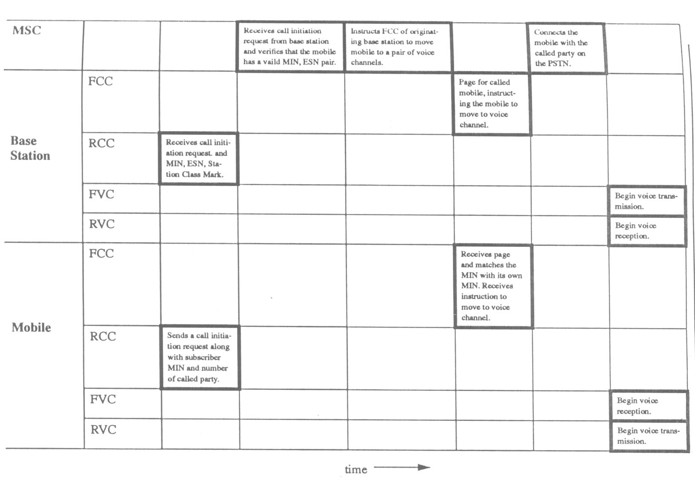
Timing Diagram when a call is made by a Mobile user to a Landline User

Slide 49
Roaming
All cellular systems provide a service called roaming.
  This allows subscribers to operate in service areas other than the one from which service is subscribed.
  When a mobile enters a city or geographic area that is different from its home service area, it is registered as a roamer in the new service area.
  Periodically, the MSC issues a global command over each
  FCC in the system, asking for all mobiles which are previously unregistered to report their MIN and ESN over the RCC for billing purposes.
  If a particular mobile user has roaming authorization for billing purposes, MSC registers the subscriber as a valid roamer.

Slide 50
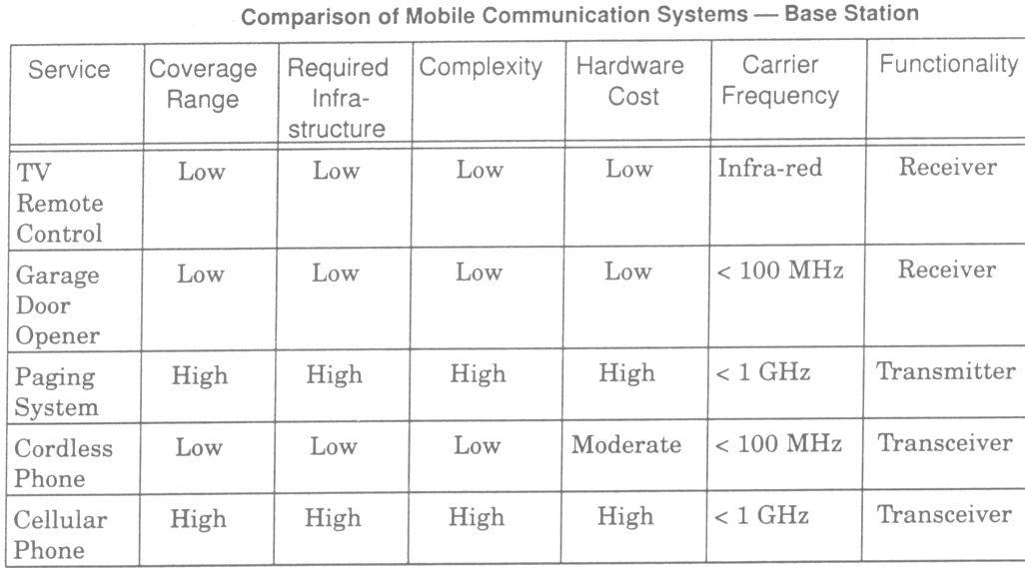
Comparison of Common Mobile Radio Systems
( at Base Station)

